Slide 1




PRESENTATION
DATA VISUALIZATION
IMDB DATASET
Presented by:
Abdul Ahad
Ahmed Raza
Hammad Ahmed
Aqib Raza

Slide 2
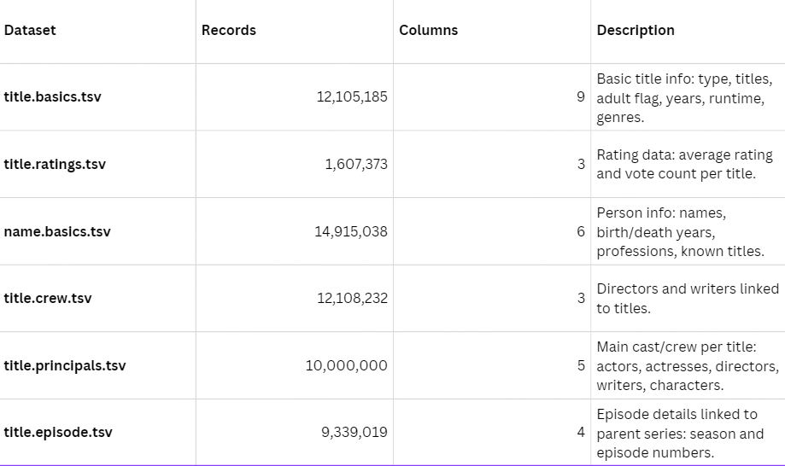
Purpose Of EDA
The purpose of this EDA is to understand the IMDb datasets used in this project. By examining their structure and contents such as titles, genres, ratings, and crew information we can identify missing or inconsistent data and explore key trends within the film industry.
This EDA begins our story with the IMDb datasetswhere every title, rating, and genre becomes a character. By exploring this data, we uncover hidden patterns, resolve inconsistencies, and reveal the trends that shape the film industry narrative.
THE ROLE OF STORY TELLING

Slide 3
DATA WRANGLING
DATA WRANGLING
Category | Details
Before Cleaning | Shape: 1,607,096 × 13 • Memory: 705.05 MB • Missing values: 2,663,207
Missing Values (Major Columns) | endYear: 1,538,657 (95.74%) • runtimeMinutes: 472,476 (29.40%) • writer: 381,162 (23.72%) • director: 270,912 (16.86%)
Cleaning Actions | directors imputed: 270,912 • writers imputed: 381,162 • runtimeMinutes kept • endYear left valid missing
After Cleaning | Shape: 1,607,096 × 15 • Missing values: 2,011,133 • Reduction: 652,074
Remaining Missing | endYear (valid), runtimeMinutes (accepted)
Duplicates | Checked 1,607,354 rows → No duplicates found
Outliers | Not removed (valid runtime variations)
Category | Details
Before Cleaning | Shape: 1,607,096 × 13 • Memory: 705.05 MB • Missing values: 2,663,207
Missing Values (Major Columns) | endYear: 1,538,657 (95.74%) • runtimeMinutes: 472,476 (29.40%) • writer: 381,162 (23.72%) • director: 270,912 (16.86%)
Cleaning Actions | directors imputed: 270,912 • writers imputed: 381,162 • runtimeMinutes kept • endYear left valid missing
After Cleaning | Shape: 1,607,096 × 15 • Missing values: 2,011,133 • Reduction: 652,074
Remaining Missing | endYear (valid), runtimeMinutes (accepted)
Duplicates | Checked 1,607,354 rows → No duplicates found
Outliers | Not removed (valid runtime variations)

Slide 4
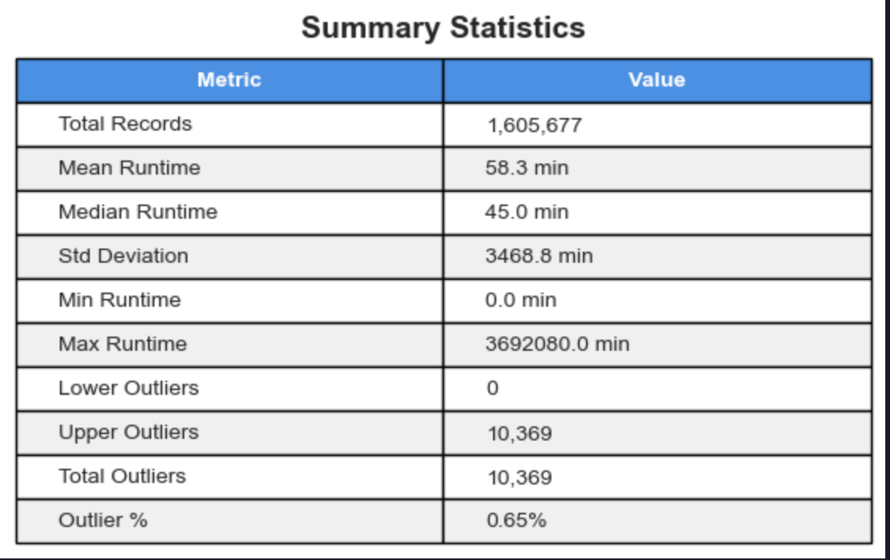
OUTLIER SUMMARY
The dataset contains 1,605,677 Total Records of media runtimes.
The data is highly right-skewed because the Mean Runtime (58.3 min) is significantly higher than the Median Runtime (45.0 min).
The extremely high Standard Deviation (3468.8 min) is due to the presence of massive outliers, like the Max Runtime (3,692,080.0 min).
There are 10,369 Upper Outliers, accounting for 0.65% of the total records.
The outlier chart shows these extreme runtimes are concentrated in non-standard categories: tvMiniSeries (7.7%) and tvSpecial (7.4%).
In contrast, standardized media like tvEpisode (0.2%) and movie (0.6%) have very low outlier percentages, meaning they adhere closely to their typical runtimes.

Slide 5
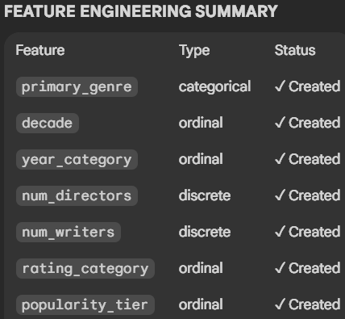
Feature Engineering :
Key Transformations
rating_category: The original numerical ratings were converted into an ordinal scale to improve interpretability.
Example: Ratings were mapped to categories like Excellent, Very Good, Good, Average, Poor, etc.
decade: A new ordinal column was created by grouping release years.
Goal: Every movie is now categorized into the specific decade (e.g., 1990s, 2000s) it was released in.
primary_genre: For movies listing multiple genres, a new categorical column was created to assign a single, representative primary genre.
Purpose: This simplifies analysis and modeling by focusing on the most dominant genre.

Slide 6
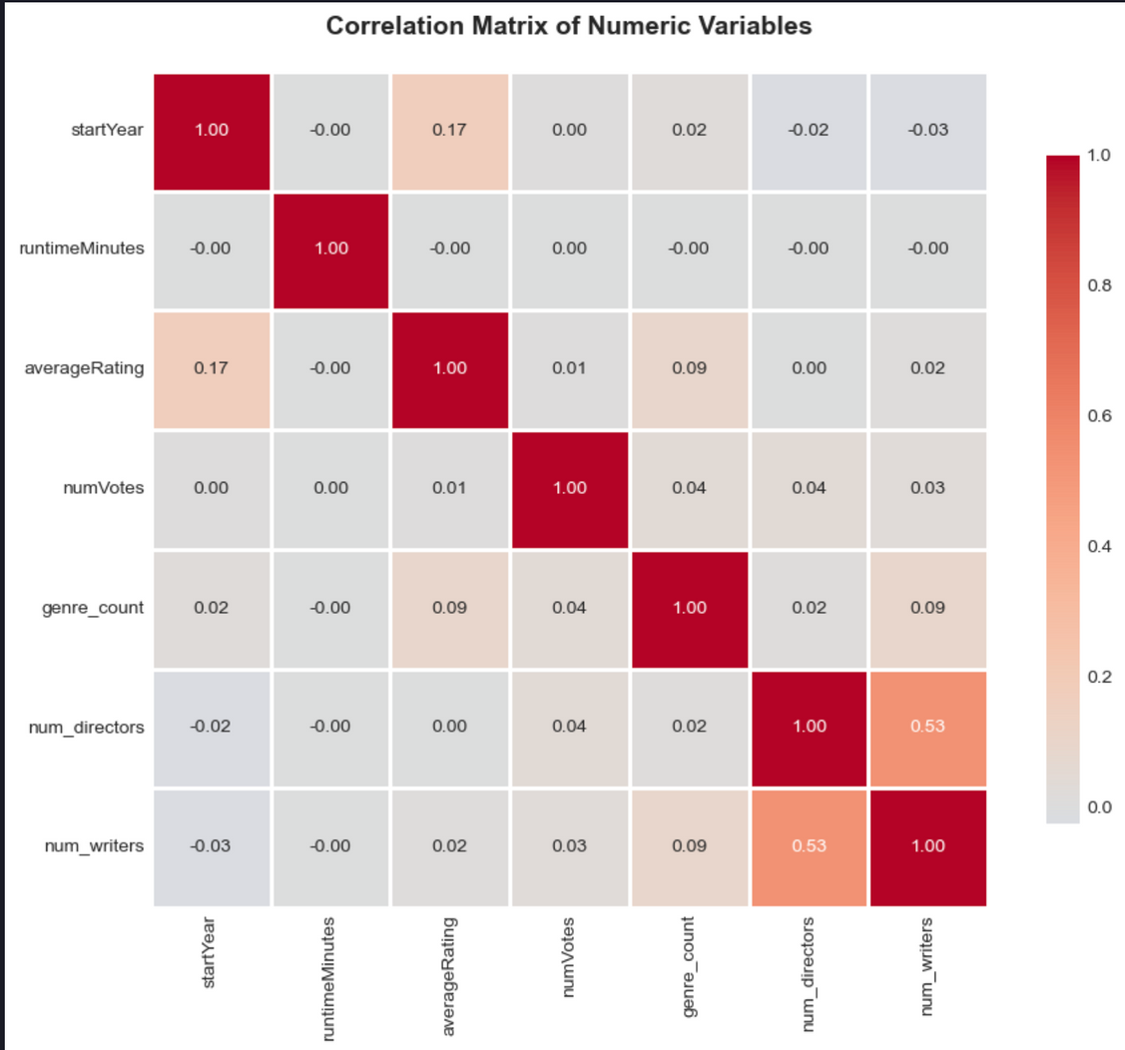
CORRELATION MATRIX
That correlation matrix is pretty clear: when it comes to media, size (runtime) doesn't equal quality (rating). Most of the values are basically zero, which tells us there’s no linear connection between how long something is and how good people rate it, or even how many votes it gets. The only real link we see is a moderate one ($0.53$) between the number of directors and the number of writers, which makes perfect sense—big, complicated projects need more people on both fronts. Otherwise, the data suggests things like audience reception and runtime are driven by completely independent factors, not by simple trends.

Slide 7
EXPLORATORY VISUALIZATIONS

Slide 8
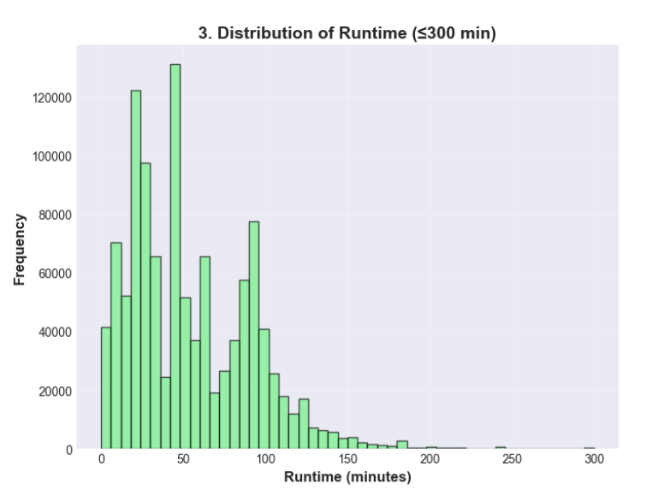
MOVIES RUNTIME
The runtime histogram is highly multimodal, reflecting a mix of media types. The data strongly peaks around:
40-50 min (most common): Typical hour-long TV episode.
90-100 min: Standard feature film length.
20-30 min: Standard half-hour TV episode.
The distribution is right-skewed, meaning very long content is infrequent compared to these dominant, shorter formats.

Slide 9
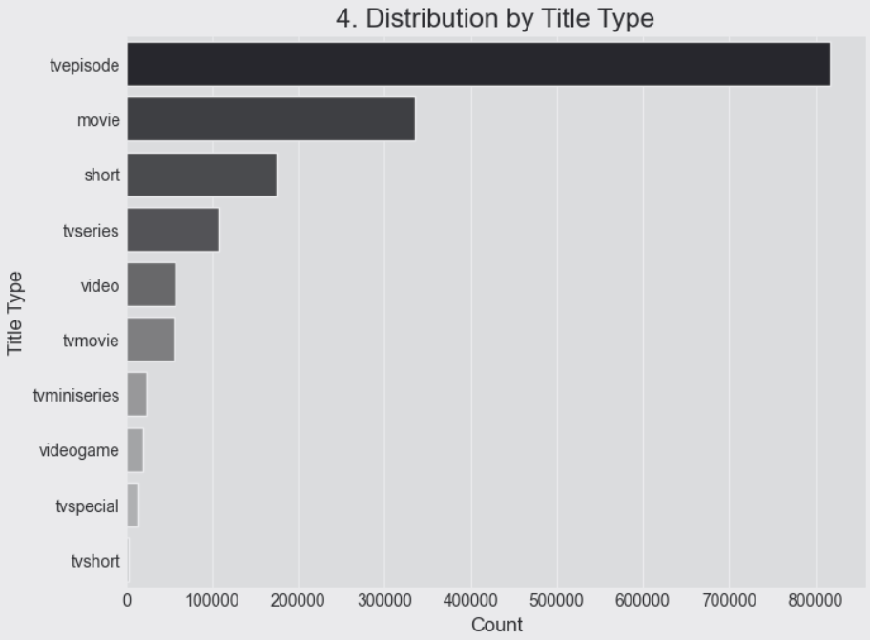
DISTRIBUTION BY TITLE TYPE
The visualization clearly highlights the imbalance in the dataset, indicating that the majority of the data points are related to TV programming (tvepisode, tvseries, etc.), with tvepisode being the most prevalent title type by a large margin. This distribution is crucial for subsequent analysis, as it suggests that models or analyses might be disproportionately influenced by the characteristics of TV episodes.

Slide 10
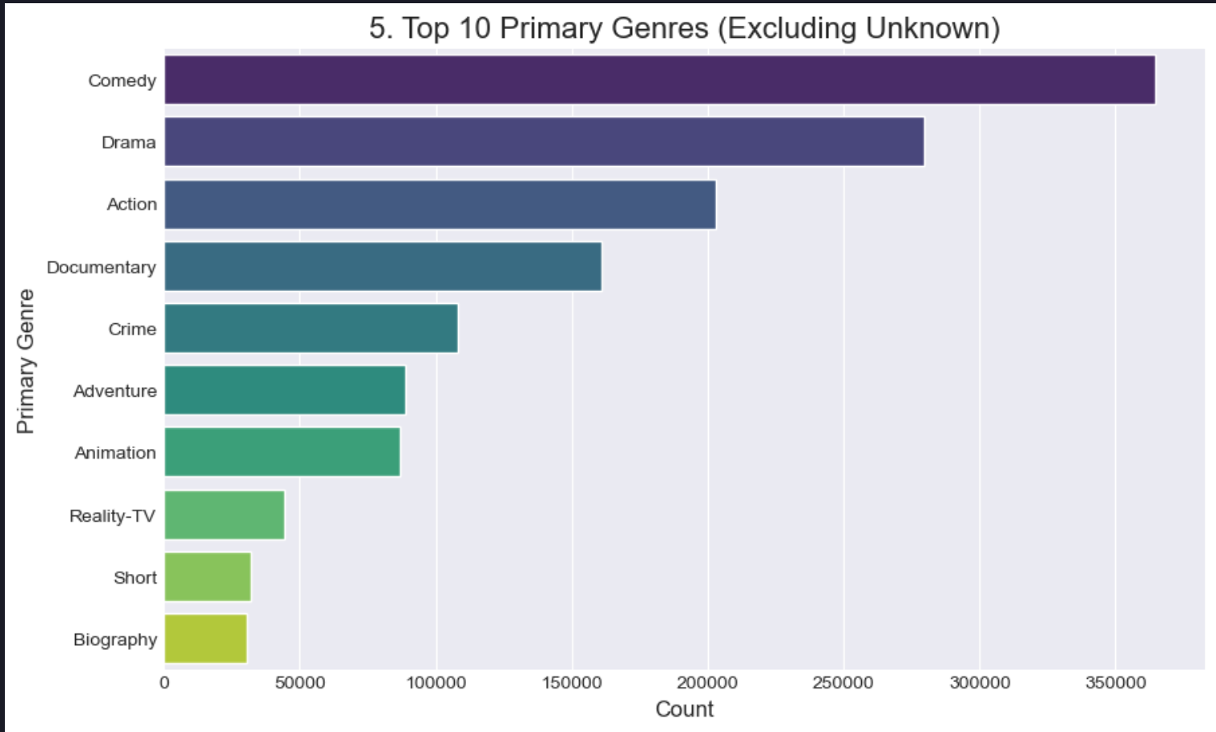
TOP 10 GENRE
Comedy: ~365,000 – most dominant genre
Drama: ~280,000 – strong presence across titles
Action: ~205,000 – popular high-energy content
Documentary: ~160,000 – factual storytelling
Crime: ~110,000 – narrative-driven crime stories
Adventure: ~90,000 – often paired with Action or Animation
Animation: ~85,000 – family-friendly and fantasy content
Reality-TV: ~45,000 – growing non-scripted segment
Short: ~30,000 – niche, small-format productions
Biography: ~28,000 – real-life stories and events

Slide 11
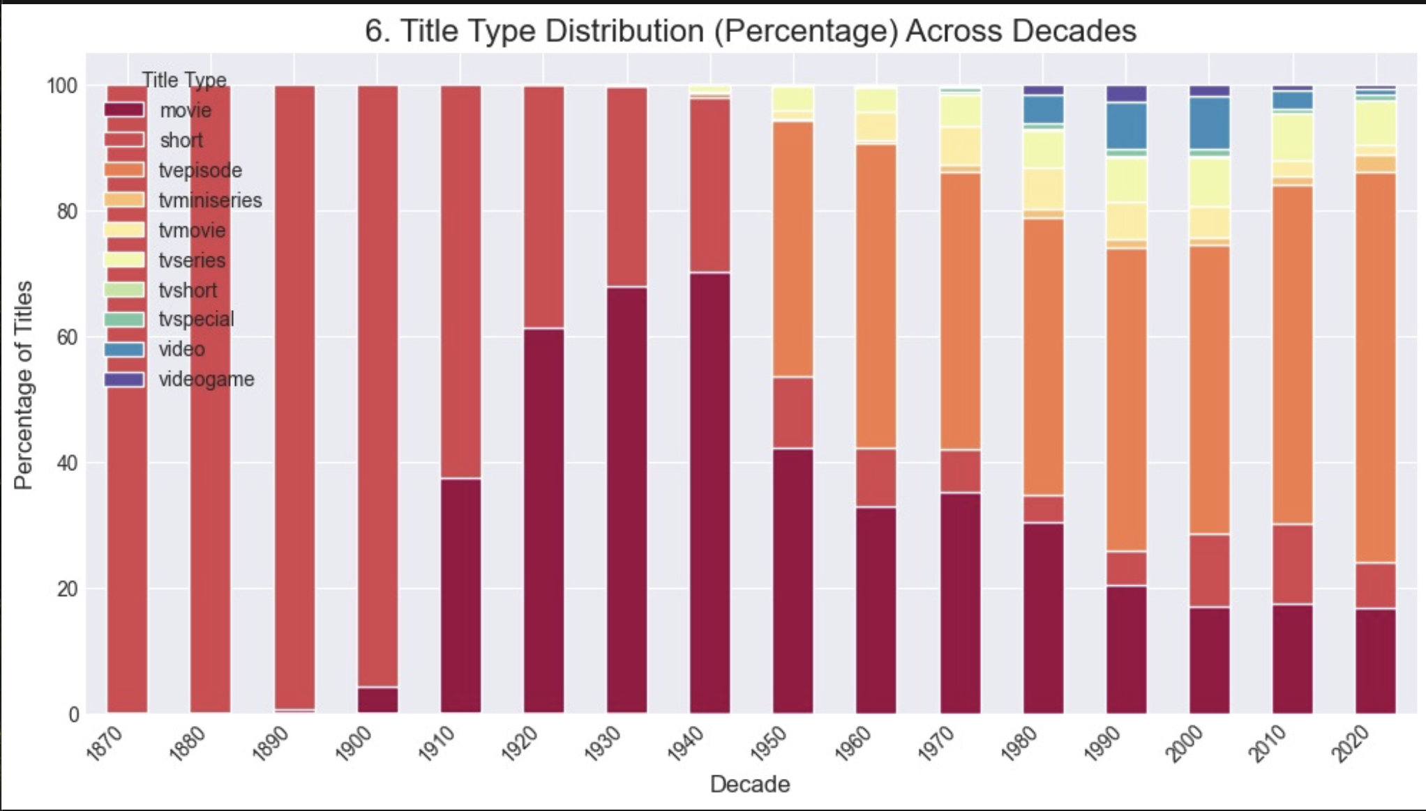
TITLE TYPE DISTRIBUTION ACROSS DECADES
Title Type Distribution (Percentage) Across Decades
Early Dominance: Movies (dark red) dominated content production in the pre-1940s era.
Shift Over Time: From the 1950s onward, TV episodes (orange) and other TV-related content increased significantly.
Industry Trend: This reflects a long-term shift from film-centric to television-focused production.

Slide 12
EXPLANATORY VISUALIZATIONS
Main Narrative:
Optimizing Content for Audience Preference
The goal is to determine the optimal combination of Genre, Run Time, Episode Count, and Title Type (e.g., Movie vs. Series) that best aligns with audience preferences and trends.

Slide 13

RUNTIME VS RATING
The following slides present key insights into how runtime influences audience ratings, highlighting patterns, trends, and performance differences across major title types

Slide 14
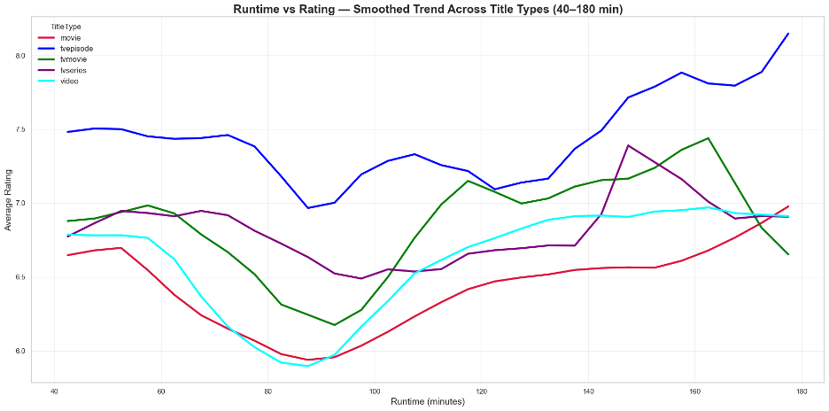
RUNTIME VS RATING(LINE CHART)

Slide 15
FINAL RESULTS
Title Type | Best Runtime Range (Highest Ratings) | Weak Runtime Range (Lowest Ratings) | Overall Trend / Interpretation
Movie | 150–180 min | 75–100 min | U-shape: Ratings dip sharply around 75–100 min (likely low-budget/fast-produced content). Longer movies (150–180 min) perform better, indicating deeper narrative films.
TV Episode | 150–180 min (unusually long) | 85–135 min | Mostly upward: Episodes start high (~7.5), dip mid-range, then climb dramatically after 140 min — likely TV specials or extended finales with higher production quality.
TV Movie | 140–170 min | 80–95 min | Strong U-shape: Similar to theatrical films but with a more dramatic dip around 80–95 min. Peaks near 160 min, indicating long-format TV movies are better received.
TV Series | 145–155 min | 90–100 min | Mild U-shape → upward spike: Start strong (~7.0), dip near 90–100 min, then spike around 145–155 min — correlates with documentary-style episodes or finales.
Video | 140–170 min | 75–95 min | U-shape: Weak short runtimes (<95 min) and strong long-form content (>140 min). Longer content correlates with higher production quality.

Slide 16


SUMMARY OF RUNTIME VS RATING
Across all title types, runtime and ratings follow a clear U-shaped pattern. The weakest ratings occur between 80–100 minutes, while longer content (especially above 140 minutes) performs signifaicantly better. TV episodes consistently achieve the highest ratings across all runtimes. Overall, short and mid-length content underperforms, whereas long-duration productions show strong audience approval.

Slide 17

GENRE PAIRS
The following slides present key insights into the most common and highest-rated genre pairs, highlighting dominant combinations, audience preferences, and rating patterns across genres

Slide 18
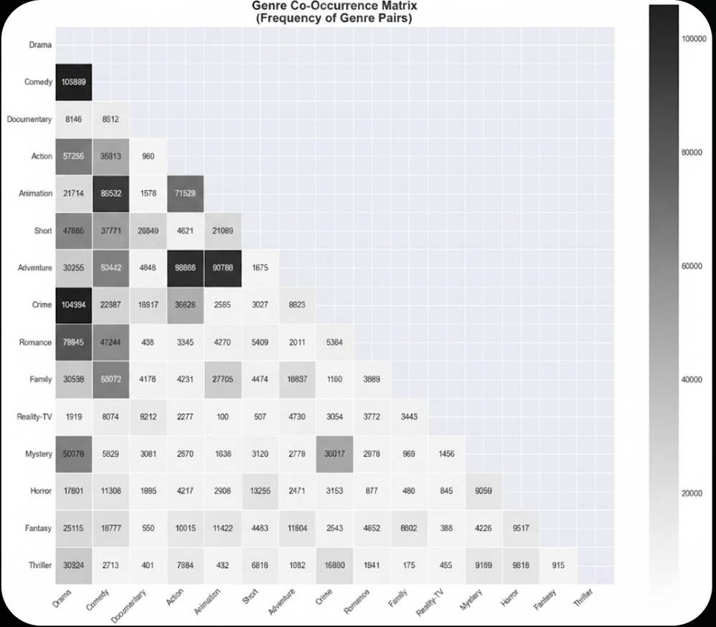
GENRE CO-OCCURENCE MATRIX
The Genre Co-Occurrence Matrix highlights the most frequent genre pairings across titles.
Crime + Drama is the strongest combination with 104,394 occurrences.
Action + Adventure follows as a highly expected and popular pairing with 90,786 titles.
Comedy + Animation is another strong mix with 85,532 occurrences.
Overall, the data shows that while certain pairs dominate, genre blending remains selective and purposeful.

Slide 19
Top 10 Most Common Genre Pairs and Their Ratings
Rank | Genre Pair | Frequency (Titles) | Avg IMDb Rating
1 | Comedy + Drama | 105,889 | 7.21
2 | Crime + Drama | 104,984 | 7.23
3 | Action + Adventure | 93,986 | 7.26
4 | Adventure + Animation | 90,788 | 7.31
5 | Animation + Comedy | 85,532 | 7.2
6 | Drama + Romance | 79,945 | 7.08
7 | Action + Animation | 71,529 | 7.43
8 | Action + Drama | 57,255 | 7.15
9 | Adventure + Comedy | 53,442 | 7.07
10 | Comedy + Family | 53,072 | 7.24

Slide 20
SUMMARY OF
GENRE-PAIR
Genre pairings show clear patterns in both popularity and audience ratings. Common combos like Comedy + Drama, Crime + Drama, and Action + Adventure dominate due to strong viewer appeal. High-rated pairs such as Action + Animation and Adventure + Animation perform especially well, while less compatible blends tend to rate lower. Overall, successful genre mixing is selective, with certain pairs consistently delivering stronger audience reception.

Slide 21

TV SERIES STRUCTURE
NO OF EPISODES
GENRE-WISE
How No Episodes/Seasons effect the overall rating of a TV-Show.
Which Genre is most liked when it comes to TV-Shows.

Slide 22
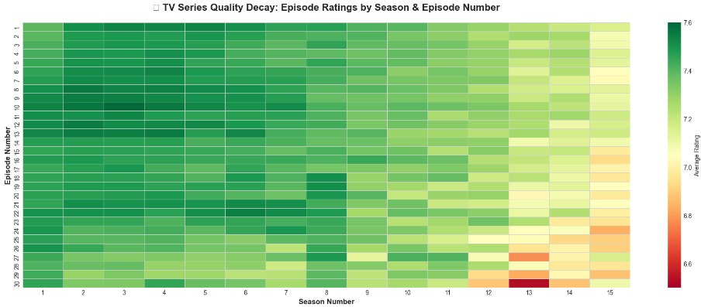
TV Series Quality Decay: Episode Ratings by Season & Episode Number

Slide 23
Season Wise Rating Trends and Key Insights
Finding Category | Observation / Insight
Early-Season Strength | Seasons 1–3 maintain a high, stable average rating of ≈7.49, indicating strong openings and high viewer engagement.
Peak Rating Period | Ratings peak around Seasons 2–4 (≈7.50) before a gradual decline begins.
Mid-Series Ratings | Seasons 5–8 show mild slippage (7.47 → 7.43), suggesting slight fatigue or narrative stagnation.
Onset of Decline | A more noticeable downward trend starts after Season 8.
Late-Season Decline | By Seasons 9–10, ratings fall to 7.37 → 7.35, reflecting reduced viewer satisfaction.
Magnitude of Decline | Ratings drop by 0.34 points from early seasons (7.49) to the final seasons (≈7.15).
Error Bar Interpretation | Larger error bars indicate high variability in episode ratings within seasons, especially mid-series.
Genre Influence (Context) | Long-running series often mix Drama, Crime, Comedy, and Action—genres that start strong but face narrative fatigue over extended runs.

Slide 24
TV SERIES SUMMARY
TV series ratings start strong in early seasons (≈7.49), peak around Seasons 2–4, then gradually decline from mid-series onward. By the final seasons, average ratings drop to ≈7.15, reflecting narrative fatigue. Ratings variability is higher mid-series, and genre blending (Drama, Crime, Comedy, Action) influences both early momentum and late-season performance.

Slide 25


GENRE PREFERENCE BY
REGION
These slides highlight how viewer ratings vary across regions and show the most popular genre preferences. Key patterns reveal audience trends and preferences in different locales.

Slide 26
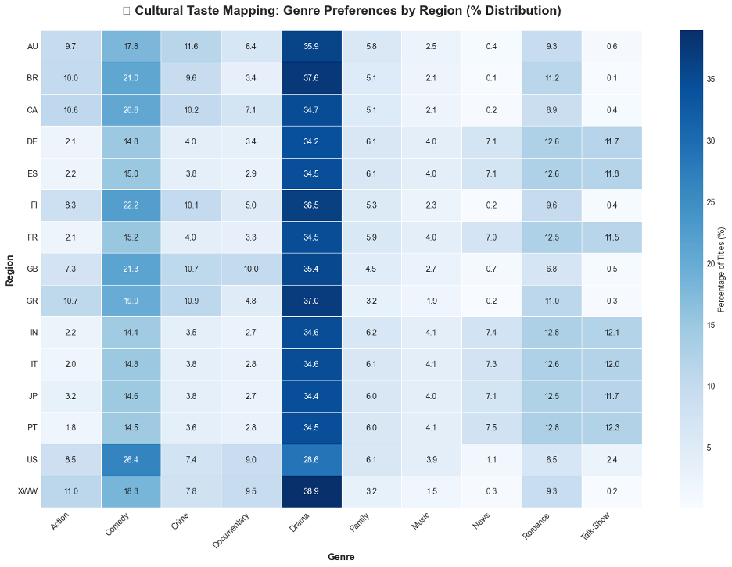
Genre Preferences by Region (% Distribution)

Slide 27
Regional Genre Preferences & Market Insights
Genre / Category | Key Regions / Markets | Observation / Insight
Drama & Comedy | Global (all regions) | Drama dominates (30–38%); drama-comedy hybrids have the highest chance of international success.
Romance | PT, IN, ES, JP, FR | Romance-focused movies perform best in Southern Europe, India, and Japan (>12% preference).
Action & Sci-Fi | US, FI, GR, MX | Action and sci-fi titles are strong performers in these markets.
Documentaries | UK, CA, FI, Global (XWW) | Documentary releases are best suited for UK, Canada, Finland, and global online platforms.
Family & Animation | JP, IN, CA, BR | High demand for family/children content; ideal for animated and family films.
News / Talk Shows | DE, ES, FR, JP | These regions favor informational and culturally grounded content.

Slide 28
Global and Regional Genre Trends
Viewer preferences vary by region: Drama and Comedy dominate globally, while Romance performs best in Southern Europe, India, and Japan. Action and Sci-Fi are popular in the US, Finland, Greece, and Mexico, whereas Documentaries thrive in the UK, Canada, and global platforms. Family and Animation content is favored in Japan, India, Brazil, and Canada, and News/Talk shows see higher demand in Germany, Spain, France, and Japan.

Slide 29
AVERAGE RATING BY CAST SIZE & DIRECTORS
The next slides will show how average IMDb ratings vary with cast size, highlighting which cast sizes tend to perform best with audiences.

Slide 30
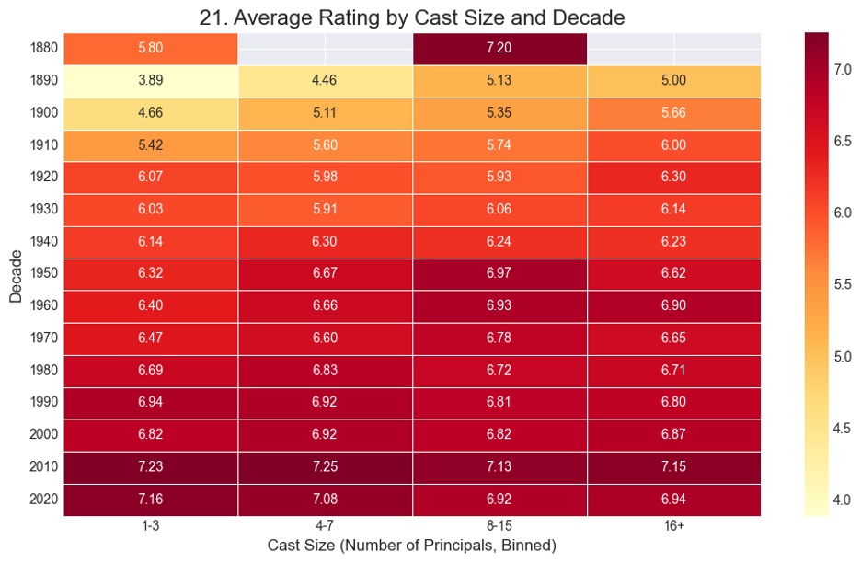
Average Rating by Cast Size and Decade

Slide 31
Impact of Directors and Cast Size on Film Ratings
Finding / Concept | Key Insight / Data | Narrative / Interpretation
“More Heads Are Better” (Director Count) | Average ratings increase with more directors: solo = 6.9, duo = 7.1, trio = 7.2 | Collaborative direction in complex productions (e.g., high-budget animations, anthologies) improves quality and mitigates risk, outperforming solo directors.
Director’s S-Curve: Potential vs. Consistency | Most directors peak above debut; career patterns: Declined (~19,000), Stable, Improved (~10,000) | Directors often have breakout hits, but sustaining high-quality output over a long career is rare; most experience gradual decline after peak.
“Ensemble Sweet Spot” (Cast Size & Decades) | 2010s films with 8–15 principal cast members have highest ratings (~7.25); small casts (1–3) average ~6.5 | Modern audiences favor large, character-rich ensembles (cinematic universes, crossovers); small-cast films underperform compared to past decades.

Slide 32
SUMMARY OF CAST SIZE & DECADES OVER RATING
Films with multiple directors tend to receive higher ratings, highlighting the benefits of creative collaboration. Directors often peak after their debut, but sustaining high-quality output over a career is rare. Larger ensemble casts, especially 8–15 members in recent decades, consistently earn higher ratings, showing audiences favor character-rich, complex stories.

Slide 33
THANK YOU!
ANY QUESTIONS!!

